Slide 1
Chameleon: A hierarchical Clustering Algorithm Using Dynamic Modeling
  By George Karypis, Eui-Hong Han,Vipin Kumar
    and not by Prashant Thiruvengadachari

Slide 2
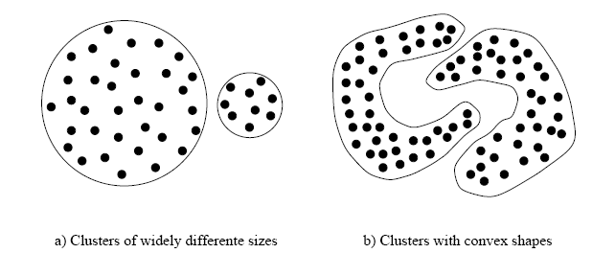
Existing Algorithms
K-means and PAM
  Algorithm assigns K-representational points to the clusters and tries to form clusters based on the distance measure.

Slide 3
More algorithms
Other algorithm include CURE, ROCK, CLARANS, etc.
CURE takes into account distance between representatives
ROCK takes into account inter-cluster aggregate connectivity.

Slide 4
Chameleon
Two-phase approach
Phase -I
  Uses a graph partitioning algorithm to divide the data set into a set of individual clusters.
Phase -II
  uses an agglomerative hierarchical mining algorithm to merge the clusters.

Slide 5
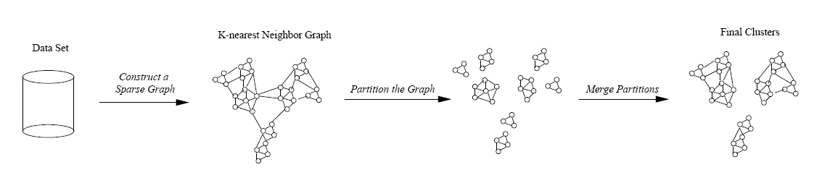
So, basically..

Slide 6
Why not stop with Phase-I? We've got the clusters, haven't we ?
  Chameleon(Phase-II) takes into account
    Inter Connetivity
    Relative closeness
  Hence, chameleon takes into account features intrinsic to a cluster.

Slide 7
Constructing a sparse graph
Using KNN
  Data points that are far away are completely avoided by the algorithm (reducing the noise in the dataset)‏
  captures the concept of neighbourhood dynamically by taking into account the density of the region.

Slide 8
What do you do with the graph ?
Partition the KNN graph such that the edge cut is minimized.
  Reason: Since edge cut represents similarity between the points, less edge cut => less similarity.
Multi-level graph partitioning algorithms to partition the graph – hMeTiS library.

Slide 9
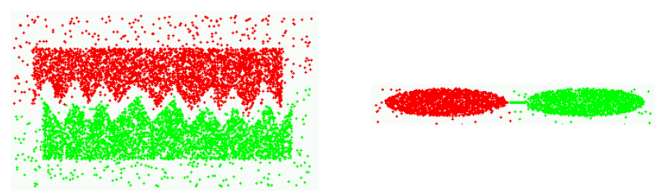
Example:

Slide 10
Cluster Similarity
Models cluster similarity based on the relative inter-connectivity and relative closeness of the clusters.

Slide 11
Relative Inter-Connectivity
Ci and Cj
  RIC= AbsoluteIC(Ci,Cj)‏
  internal IC(Ci)+internal IC(Cj) / 2
  where AbsoluteIC(Ci,Cj)= sum of weights of edges that connect Ci with Cj.
  internalIC(Ci) = weighted sum of edges that partition the cluster into roughly equal parts.

Slide 12
Relative Closeness
Absolute closeness normalized with respect to the internal closeness of the two clusters.
Absolute closeness got by average similarity between the points in Ci that are connected to the points in Cj.
  average weight of the edges from C(i)->C(j).

Slide 13
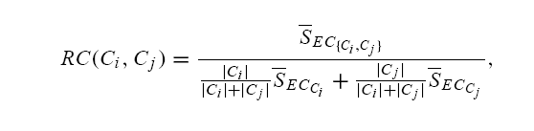
Internal Closeness….
Internal closeness of the cluster got by average of the weights of the edges in the cluster.

Slide 14

So, which clusters do we merge?
So far, we have got
  Relative Inter-Connectivity measure.
  Relative Closeness measure.
Using them,

Slide 15
Merging the clusters..
If the relative inter-connectivity measure relative closeness measure are same, choose inter-connectivity.
You can also use,
  RI (Ci , C j )≥T(RI) and RC(C i,C j ) ≥ T(RC)‏
Allows multiple clusters to merge at each level.

Slide 16
Good points about the paper :
Nice description of the working of the system.
Gives a note of existing algorithms and as to why chameleon is better.
Not specific to a particular domain.

Slide 17
yucky and reasonably yucky parts..
Not much information given about the Phase-I part of the paper – graph properties ?
Finding the complexity of the algorithm
  O(nm + n log n + m^2log m)‏
Different domains require different measures for connectivity and closeness, ...................

Slide 18
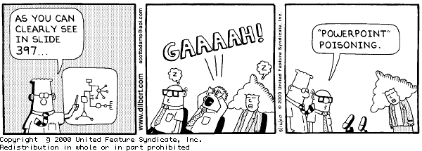
Questions ?

